Slide 1

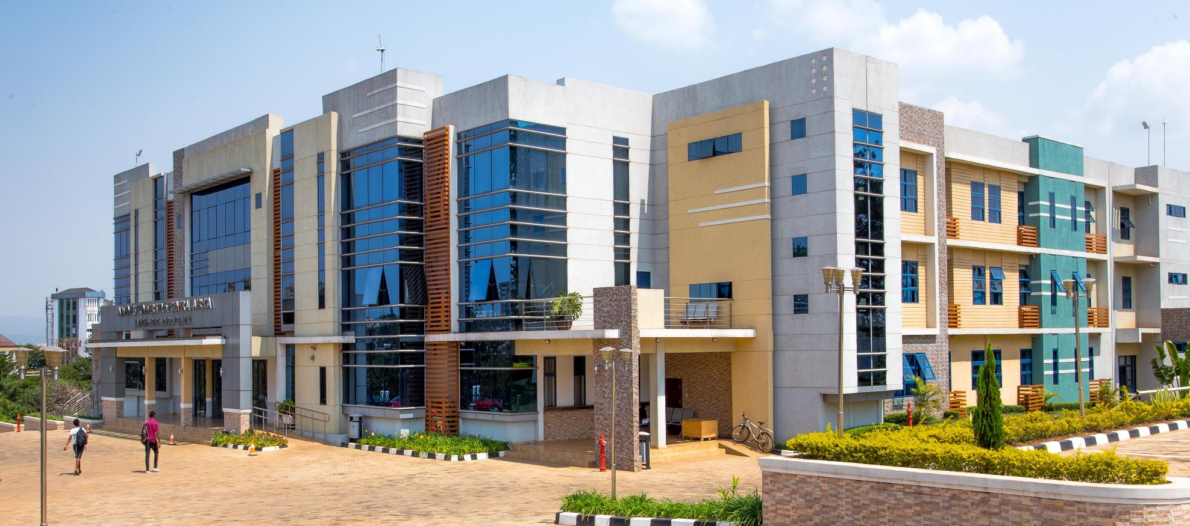
12th September, 2025
INSY 8311 Database Development with PL/SQL

Slide 2
SQL Queries – Foundations

Slide 3
HR Schema Overview
Sample database provided by Oracle for training
Contains employees, departments, jobs, locations, countries, regions
Used widely in Oracle LiveSQL environment

Slide 4
Key HR Tables
EMPLOYEES – employee details
DEPARTMENTS – department info
JOBS – job roles and salary ranges
LOCATIONS, COUNTRIES, REGIONS – geographical structure

Slide 5
Relationships in HR Schema
Employee works in a Department
Department located in a Location
Location belongs to a Country
Country belongs to a Region
Employee has a Job and reports to a Manager

Slide 6
SELECT Basics
SELECT retrieves data from a table
Example: SELECT * FROM employees;
Useful for exploring structure, not for production use

Slide 7
SELECT Specific Columns
Choose only required columns
Example: SELECT first_name, last_name, salary FROM employees;

Slide 8
Aliases and Calculated Columns
Aliases rename columns for readability
Use AS keyword or omit it
Example: SELECT first_name AS 'First Name', salary*12 AS 'Annual Salary' FROM employees;

Slide 9
String Concatenation
Use || operator or CONCAT function
Example: SELECT first_name || ' ' || last_name AS full_name FROM employees;

Slide 10
Handling NULLs
Use IS NULL / IS NOT NULL to check
Use NVL() to replace with default value
Example: SELECT NVL(commission_pct, 0) FROM employees;

Slide 11
WHERE Clause Basics
Filters rows returned by query
Example: SELECT first_name, salary FROM employees WHERE salary > 10000;

Slide 12
Comparison Operators
=, <>, !=, >, <, >=, <=
Used for equality and inequality checks
Both <> and != mean not equal.

Slide 13
String & Pattern Matching
LIKE 'a%’
Like ‘%a’
Like ‘%a%’
Like ‘_%’

Slide 14
BETWEEN & IN
BETWEEN: WHERE salary BETWEEN 5000 AND 10000;
IN: WHERE department_id IN (10, 20, 30);

Slide 15
Logical Operators
AND, OR, NOT
Example: WHERE salary > 5000 AND department_id = 60;

Slide 16
Date Comparisons
Use DATE keyword for literals
Example: WHERE hire_date > DATE '2005-01-01';
Use EXTRACT to pull year, month, day
Example: EXTRACT(YEAR FROM hire_date) = 2007;

Slide 17
ORDER BY Basics
Sort results in ascending (ASC) or descending (DESC) order
Example: ORDER BY salary DESC;

Slide 18
ORDER BY Expressions
Can sort using calculated values
Example: ORDER BY salary*12 DESC;

Slide 19
Handling NULLs in ORDER BY
Use NULLS FIRST or NULLS LAST
Example: ORDER BY commission_pct NULLS LAST;

Slide 20
Real-World examples
How should we apply the above queries in real life?

Slide 21
Quiz(10 marks)
1. Show employees hired after 2007, sorted by hire date
2. Write a query to find employees whose first name starts with ‘A’ and who work in departments 10,20 or 30
3. Write a query to find all employees who have a salary between 4000 and 12000, and either work in department 50 or have ‘CLERK’ in their job_id, and were hired after January, 2005?
4. Write a query to show all employees sorted by hire_date(newest employees first), and for employees hired on the same date, sort by salary(highest first)?
5. Write a query to show all employees that have charater ‘A’ in their first name at the second position?

Slide 22
Single Row Functions
SELECT UPPER(first_name), LENGTH(last_name) FROM employees;
-- Uppercase conversion and string length.
SELECT ROUND(salary, 0), TRUNC(salary, 0) FROM employees;
-- Round vs. truncate numeric values.
SELECT hire_date, ADD_MONTHS(hire_date, 6) FROM employees;
-- Date arithmetic example.
SELECT TO_CHAR(hire_date, 'YYYY-MM') FROM employees;
-- Format hire dates.

Slide 23
Handling NULLs & NVL
SELECT NVL(commission_pct, 0) FROM employees;
-- Replace NULL with 0.
SELECT NVL2(commission_pct, 'Yes', 'No') FROM employees;
-- Conditional output based on NULL.

Slide 24
Conditional Logic with CASE
SELECT salary,
CASE
WHEN salary > 10000 THEN 'High'
WHEN salary BETWEEN 5000 AND 10000 THEN 'Medium'
ELSE 'Low'
END AS salary_level
FROM employees;
-- Categorize salary using CASE expression.

Slide 25
Aggregate Functions
SELECT COUNT(*), AVG(salary), MAX(salary), MIN(salary), SUM(salary) FROM employees;
-- Aggregate summary.
SELECT job_id, COUNT(*) FROM employees GROUP BY job_id;
-- Group employees by job.

Slide 26
Grouping and HAVING
SELECT department_id, AVG(salary) FROM employees GROUP BY department_id;
-- Average salary per department.
SELECT department_id, COUNT(*) FROM employees GROUP BY department_id HAVING COUNT(*) > 5;
-- Groups with more than 5 employees.

Slide 27
Real World Queries
1. Show job_id and average salary for jobs where average salary is more than 7000.
2. List departments with more than 5 employees and average salary over 8000.

Slide 28
Quiz (10 Marks)
1. Show jobs and how many employees have that job.
2. Write a query to show average salary by department, but only if average salary > 6000.
3. Count number of employees without commission.
4. List employees with salary categorized as 'Low', 'Medium', or 'High'.
5. Show total salary and average commission for each department.

Slide 29
Understanding Joins
Joins are used to retrieve data from multiple tables based on related columns.
Common relationships: EMPLOYEES → DEPARTMENTS via department_id
Types of joins: INNER, LEFT OUTER, RIGHT OUTER, FULL OUTER

Slide 30
INNER JOIN
Returns only rows where there is a match in both tables.
Rows without a match on either side are excluded
Example:
SELECT e.first_name, d.department_name
FROM employees e
JOIN departments d ON e.department_id = d.department_id;

Slide 31
LEFT OUTER JOIN
Returns all rows from the left table
If there is a match in the right table, include it.
If no match, right-side columns = NULL
Example:
SELECT e.first_name, d.department_name
FROM employees e
LEFT JOIN departments d ON e.department_id = d.department_id;

Slide 32
RIGHT OUTER JOIN
Returns all rows from the right table.
If there is a match in the left table, include it.
If no match, left-side columns=Null
Example:
SELECT e.first_name, d.department_name
FROM employees e
RIGHT JOIN departments d ON e.department_id = d.department_id;

Slide 33
FULL OUTER JOIN
Returns all rows from both tables.
Matches where possible.
If no match, fill missing side NULL.
Example:
SELECT e.first_name, d.department_name
FROM employees e
FULL OUTER JOIN departments d ON e.department_id = d.department_id;

Slide 34
SELF JOIN
A table is joined with itself.
Compare rows within the same table, like employee vs manager
Example:
SELECT e.first_name AS Employee, m.first_name AS Manager
FROM employees e
JOIN employees m ON e.manager_id = m.employee_id;

Slide 35
Cross Join
Returns the Cartesian product → every row from table A combined with every row from table B.
Rarely used unless intentional.
Example:
SELECT e.first_name, d.department_name
FROM employees e
CROSS JOIN departments d;

Slide 36
Introduction to Subqueries
Subqueries are queries nested inside another SQL statement.
Used in SELECT, FROM, or WHERE clauses.

Slide 37
Single-Row Subqueries
Returns one value (scalar subquery).
Example:
SELECT last_name, salary
FROM employees
WHERE salary > (SELECT AVG(salary) FROM employees);

Slide 38
Multiple-Row Subqueries
Returns multiple values. Use IN, ANY, ALL.
Example:
SELECT first_name
FROM employees
WHERE department_id IN (
SELECT department_id FROM departments
WHERE location_id = 1700
);

Slide 39

End!!!

